Slide 1
assignment06 – Part 1 BrobInt

Slide 2
Read
assignment06 on volosin.lmu.build before you begin

Slide 3
Part 1
The problem

Slide 4
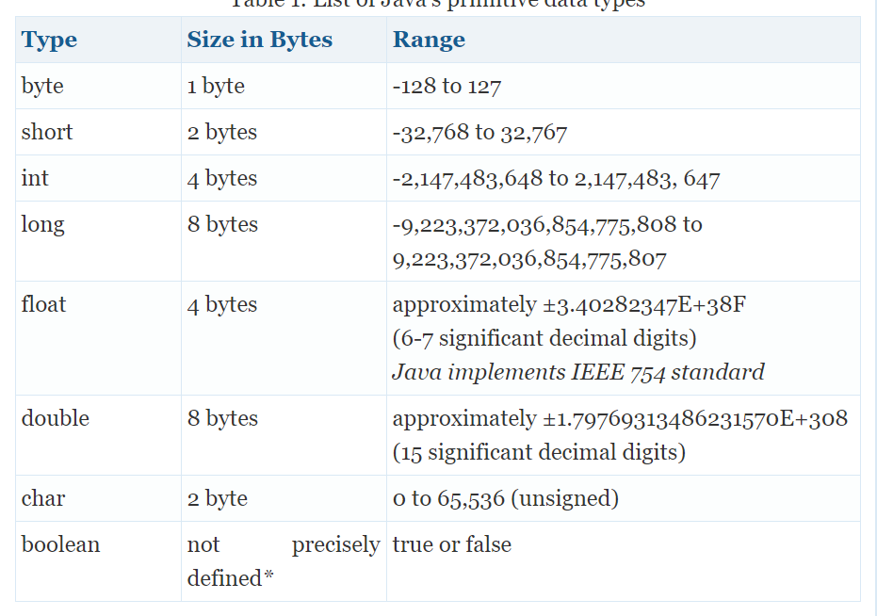
Long is the biggest primitive data type for whole numbers
Long has a max number limit of
9223372036854775807
So what happens when you want to add
9223372036854775807 + 9223372036854775807?????
Check out LetsAdd.java on my Github

Slide 5
We can add really big numbers with BigInteger
https://docs.oracle.com/javase/7/docs/api/java/math/BigInteger.html
Check out LetsAddWithBigInt.java on my Github

Slide 6
Part 2
Your turn

Slide 7
Your job is to recreate BigInteger
Addition
Subtraction
Multiplication
Division
Remainder

Slide 8
But your class will be called BrobInt
Short for Brobdinagian, a fictional land of giants from Gulliver’s Travels

Slide 9
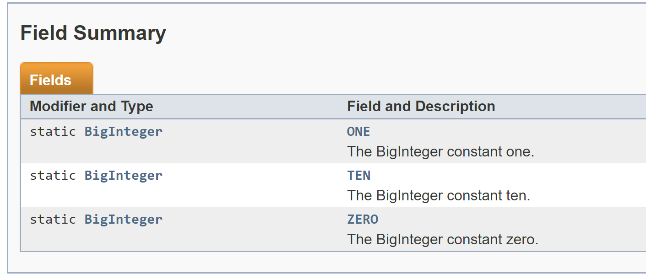
BigInteger has built in fields You should have these too!

Slide 10
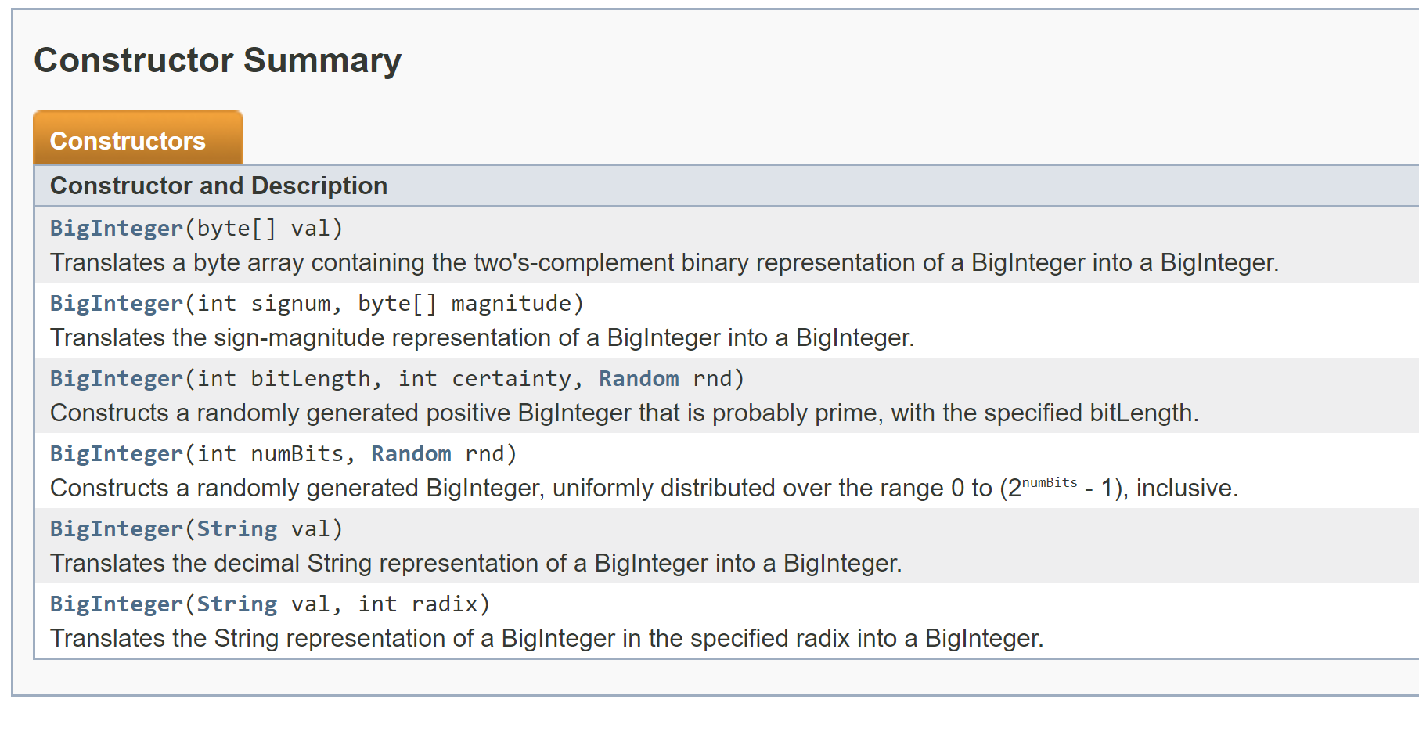
BigInteger has constructors. You should at least construct an BrobInt from a String

Slide 11
Part 3
Testing

Slide 12
Due on 04.21.20
Following a best practice known as Test Driven Development (TDD), your job is to write all of your tests for the following methods
Constructor
Addition
Subtraction
Multiplication
Division
Remainder
Check out BrobIntTester.java on my Github
~ 20 tests per method
Try to break your program!!
Negatives and positives
Positives and positives
Negatives and negatives
Zero
Multiple zeroes
Decimals
Compute with this greater than arg and vice versa

Slide 13
Part 4
Bytes

Slide 14
Store your BrobInt in an Array of Bytes
A byte consumes WAY less memory than an int. So let’s store each digit of our BrobInt in an array as a byte
Also, let’s store it backward! We will see more about this when we review addition in the next section.

Slide 15
Store your BrobInt in an Array of Bytes
new BrobInt( “123456789” );
Constructor takes in a string

Slide 16
Store your BrobInt in an Array of Bytes
CONSTRUCTOR
public BrobInt ( String val ) {
- set an internal value equal to val to store it where other methods can access it
- store reversed string value
reversed = new String(StringBuffer(value).reverse());
- store the sign
if ( value.charAt(0) == `-` ) {
sign = 1;
// remove sign from reversed
reversed = reversed.substring(0, reversed.length() – 1 );
} else if ( value.charAt(0) == `+` ) {
sign = 0;
// remove sign from reversed
reversed = reversed.substring(0, reversed.length() – 1 );
} else {
sign = 0;
}
- validateDigits();
- byteVersion = new Byte[reversed.length()];
- for each character in reversed, add that character to corresponding index in byteVersion as a byte
hint: (byte)Character.getNumericValue(reversed.charAt(i));
}

Slide 17
Part 5
Addition

Slide 18
Let’s add 123 + 2
Store reversed numbers in Array of bytes
byte[] a = new byte[reversed.length()];
byte[] b = new byte[this.reversed.length()];
byte[] c = new byte[Math.max(a.length,b.length) + 2]; //+2 to account for carrying
a = [ 3, 2, 1 ]
b = [ 2 ]
c = [ , , , , ]
Now we can add each index
c[0] = a[0] + b[0];
c[1] = a[1];
c[2] = a[2];

Slide 19
But what if we need to carry???
Store reversed numbers in Array of bytes
byte[] a = new byte[reversed.length()];
byte[] b = new byte[this.reversed.length()];
byte[] c = new byte[Math.max(a.length,b.length) + 2]; //+2 to account for carrying
a = [ 3, 2, 1 ]
b = [ 2 ]
c = [ , , , , ]
Now we can add each index
c[0] = a[0] + b[0];
c[1] = a[1];
c[2] = a[2];

Slide 20
Let’s add 998 + 98
a = [ 8, 9, 9 ]
b = [ 8, 9 ]
c = [ , , , , ]
carry = 0;
c[0] = a[0] + b[0] + carry;
if (c[0] > 9) {
c[0] = c[0] – 10;
carry = 1;
} else {
carry = 0;
}
c[1] = a[1] + b[1] = carry;
// same if as above
c[2] = a[2] + carry;
// same if as above

Slide 21
Make sure you check signs!
a > b +a –b a-b, result is positive
a < b +a –b b-a, result is negative
a = b +a –b =0
a > b -a –b a+b, result is negative
a < b -a –b a+b, result is negative
a = b -a –b a+b, result is negative
a > b +a +b a+b, result is positive
a < b +a +b a+b, result is positive
a = b +a +b a+b, result is positive
a > b -a +b a-b, result is negative
a < b -a +b b-1, result is positive
a = b -a +b =0

Slide 22
Part 6
Template

Slide 23
Template and Freebies
Static variables 1 – 10

Slide 24
Part 7
Javadoc

Slide 25
Part 8
Program and Deliverables

Slide 26
Program and Deliverables
BrobInt.java
Your program! Main method does not do anything, similar to how the Math class does not do anything. BrobInt just contains methods about BrobInts. Tests will be in a different file.
BrobIntTester.java
Your test file! First version due on 04.21.20. I expect an updated version to be uploaded with your BrobInt program
BrobInt.html
Your Javadoc!
Collatz.java
Collatz program – to be covered in a subsequent ppt
Assignment06 Lab

Slide 27
Part 9
Some other notes

Slide 28
Checking to see if a character is a valid digit
Character.isDigit( internalValue.charAt(i) )
'+' == internalValue.charAt(i)
'-' == internalValue.charAt(i)

Slide 29
Things to help you
Arrays.toString
ArrayList

